Slide 1


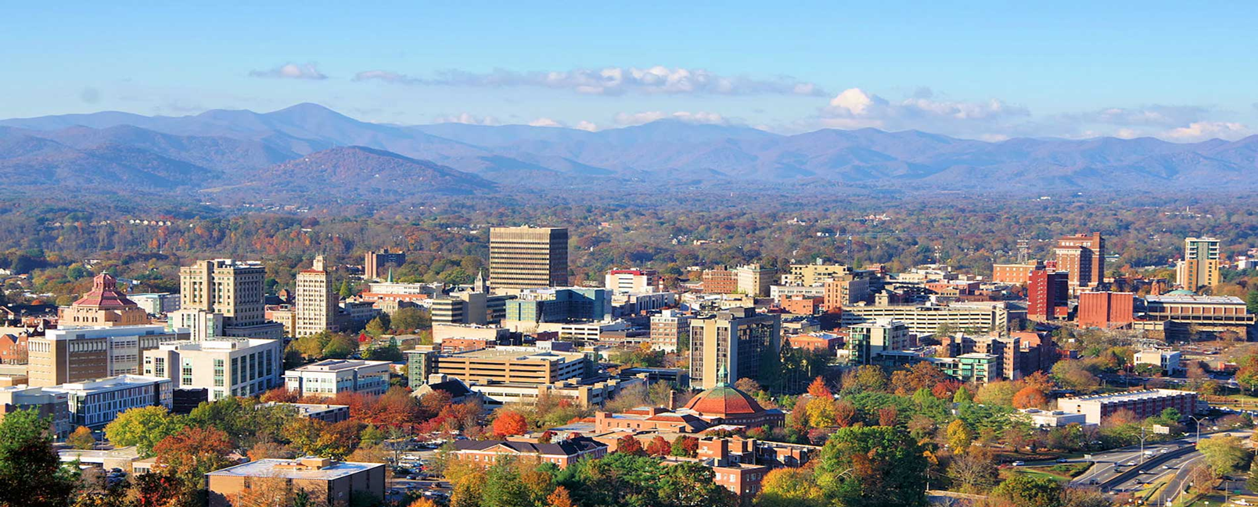
Integrating Generative AI with Traditional Urban Economics for Long-Range LUTI Modeling
2025 Fall NCMUG Meeting November 20, 2025
Colby Brown, CEO, Manhan

Slide 2
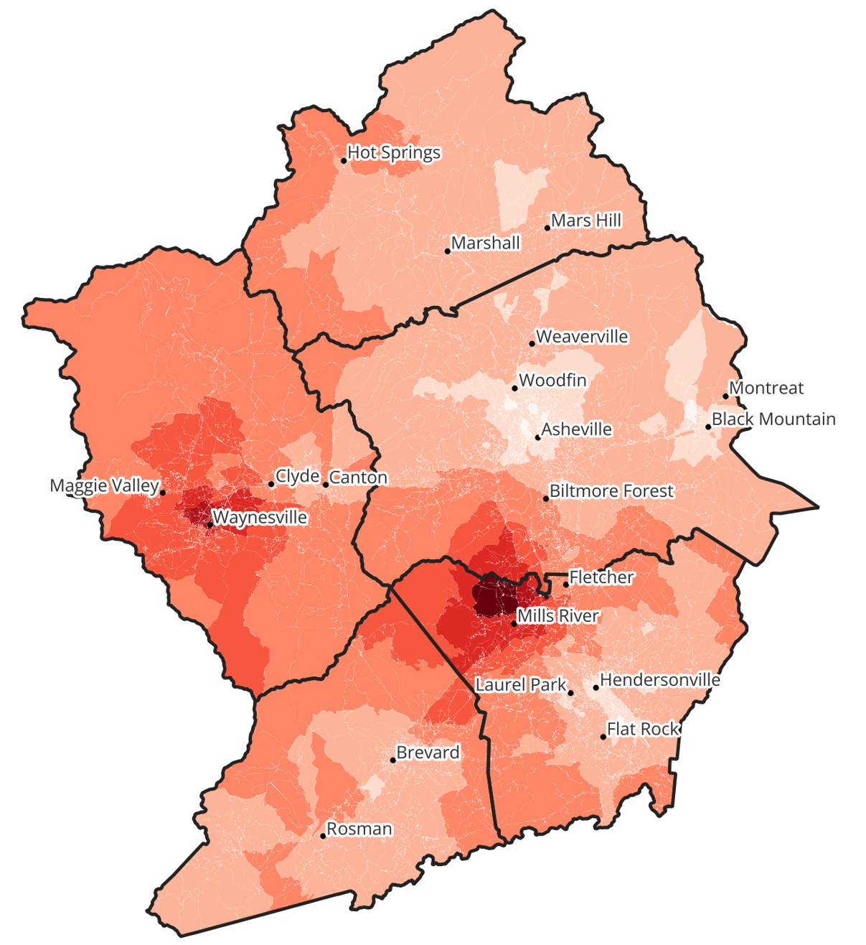
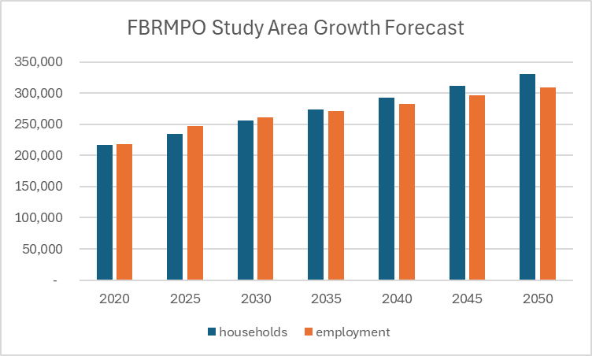

CONTEXT: GROWTH IN GREATER ASHEVILLE

Slide 3
Alternative Future Scenarios Developed by FBRMPO
Accelerated (higher growth)
Doubled household growth rate (starting in 2030)
Reduce external-internal trip volumes
Baseline (market-driven)
Projections consistent with State Demographer
Build-out capacity based upon current LU trends
Include known development projects
Consolidated (higher density)
Prefer areas that are walkable and/or served by transit
Increase multi-family housing share
Conserve green space
Dispersed (lower density)
Lower maximum density constraints
Open up land for development

Slide 4

Land Use / Transport Interaction (LUTI)
Base year run (calibrated to traffic counts)
Interim year run; accessibility metrics
Interim year run; accessibility metrics
Final horizon year run; VMT reporting
2020 Travel Model
2030 Travel Model
2040 Travel Model
2050 Travel Model
2030 Land Use
2040 Land Use
2050 Land Use
Includes known projects and Helene impacts
First feedback iteration; includes 2035 timestep
Second feedback iteration; includes 2045

Slide 5
Land Use Forecasting System
Sensitive to:
Zoning codes
Generalized land use classification
Transit service
Sewer and wastewater
Steep slopes & elevation
Protected areas
Highway access
Market forces
Component | What it does | Data source
Land Use Change | Simulate realistic land use changes using neural network | FBRMPO’s existing land use (ELUSE) parcel data
Build-out analysis | Reflect availability of land for development (by type) | ELUSE and InfoUSA employment data
Flooding impact | Estimates impact of catastrophic flooding | North Carolina FINMAN; anonymized ICEYE data
Bidding model | Represents competition in the housing market | U.S. Census American Community Survey
Allocation model | Simulate real estate development location choices | 2014-2019 Census ACS; travel model; GIS data
Travel model | Represent congestion on highways & local roads | Maintained by NCDOT

Slide 6
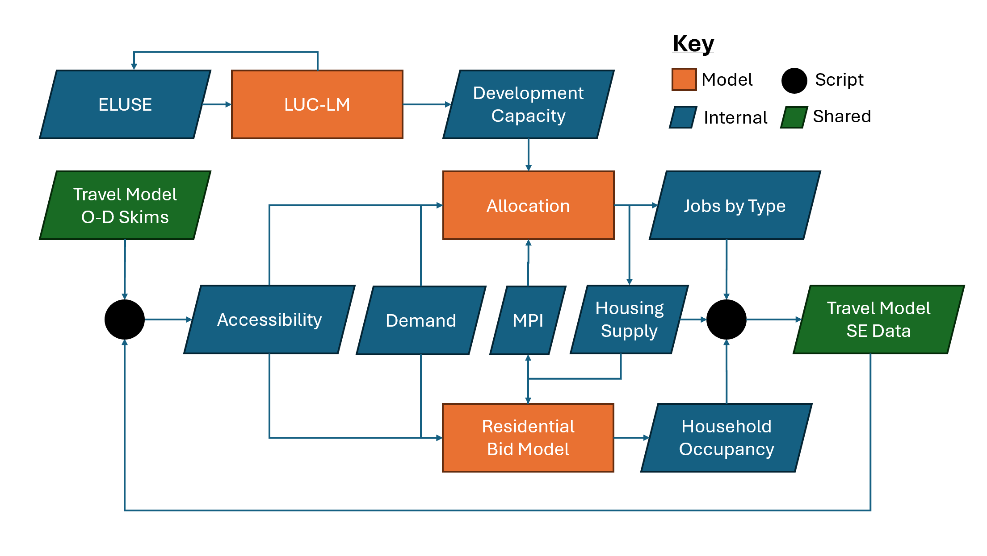

Slide 7
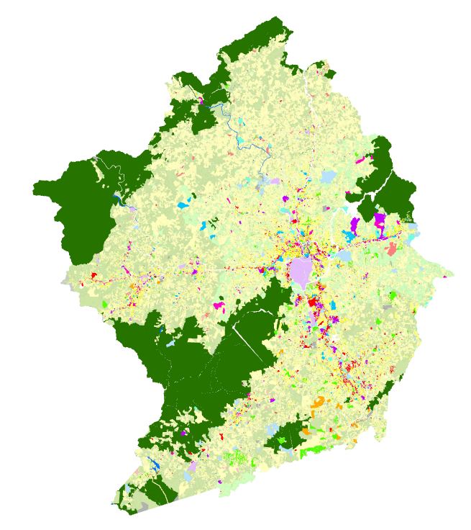
Existing Land Use and Build-out Capacity
 | Max Density (jobs per acre)
Type | Other Scenarios | Dispersed Scenario
Industrial | 16.4 | 5.2
Commercial | 41.6 | 13.1
Lodging | 11.1 | 4.0
Office | 57.9 | 19.2
Mixed-Use | 30.8 | 6.1
Institutional | 14 | 3.1
Special | 25 | 1.1
Notes:
FBRMPO maintains a parcel layer with existing land use, updated every 5 years since 2000
Residential LU types are defined using maximum density values
Non-residential max density estimated using InfoUSA data
Can be used to calculate build-out capacity by land use type
However, land uses change!

Slide 8
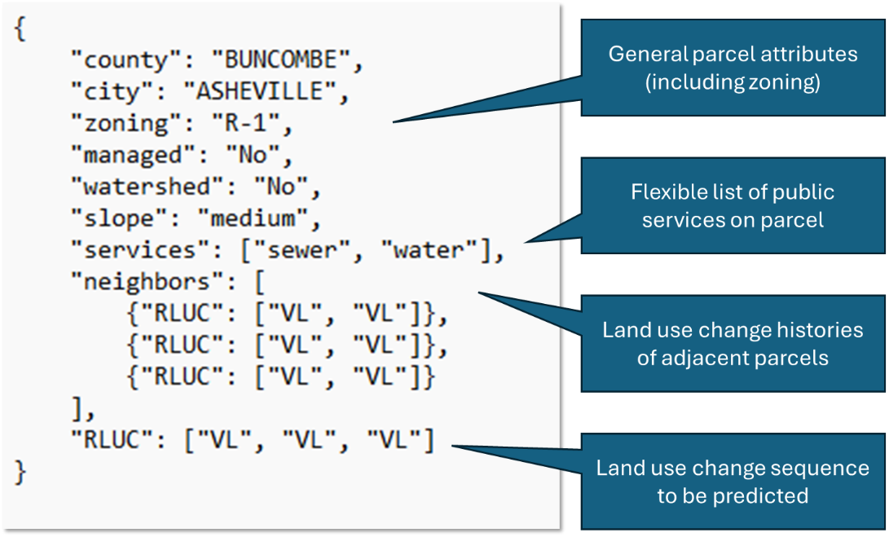
Future Land Use Prediction (1)
Land uses change!
LLMs are good at predicting “next token” in sequence
Experiment:
Code land use change history as text, with context
Fine-tune an LLM on this “corpus”

Slide 9


Future Land Use Prediction (2)
Selected model: StarCoder (v1)
Primarily a code model—unlikely that natural language use of words in training data will bias results
Base training process excluded copyrighted works from dataset
Smaller versions available to lighten the computation load
Supports relatively long context
Compatible with GGUF, Ollama
Train using Transformers library

Slide 10
Future Land Use Prediction (3)
Land Use Change Language Model (LUC-LM) results:
Over 92% accuracy for non-residential land uses
Over 80% accuracy for residential
Outperformed previous attempt using a conventional neural net
However, model is slow, even on GPU and with optimizations
Solution: screening model to determine likelihood of change

Slide 11
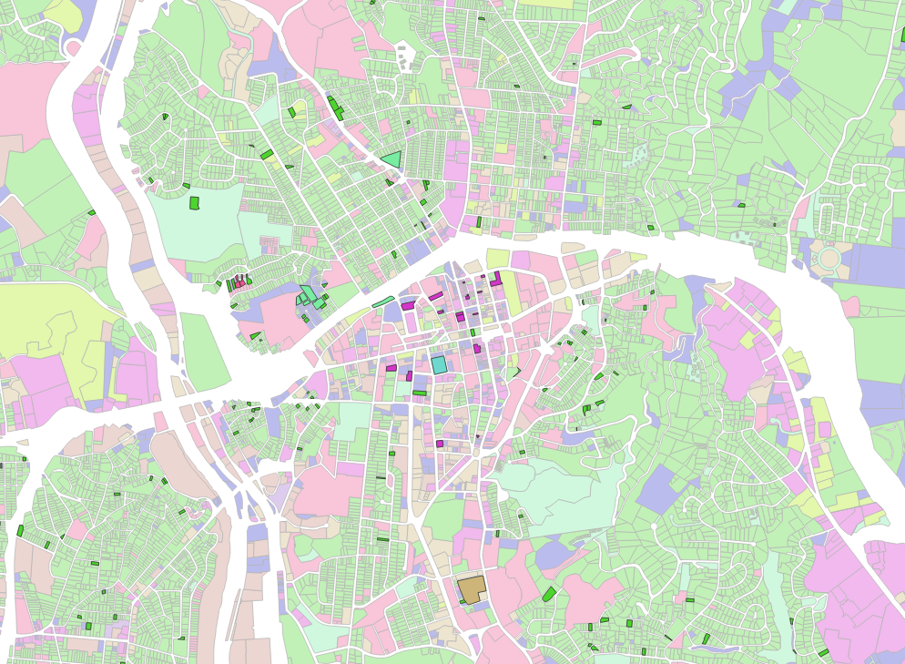
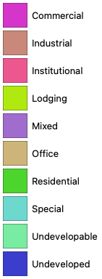
2020-2025

Slide 12
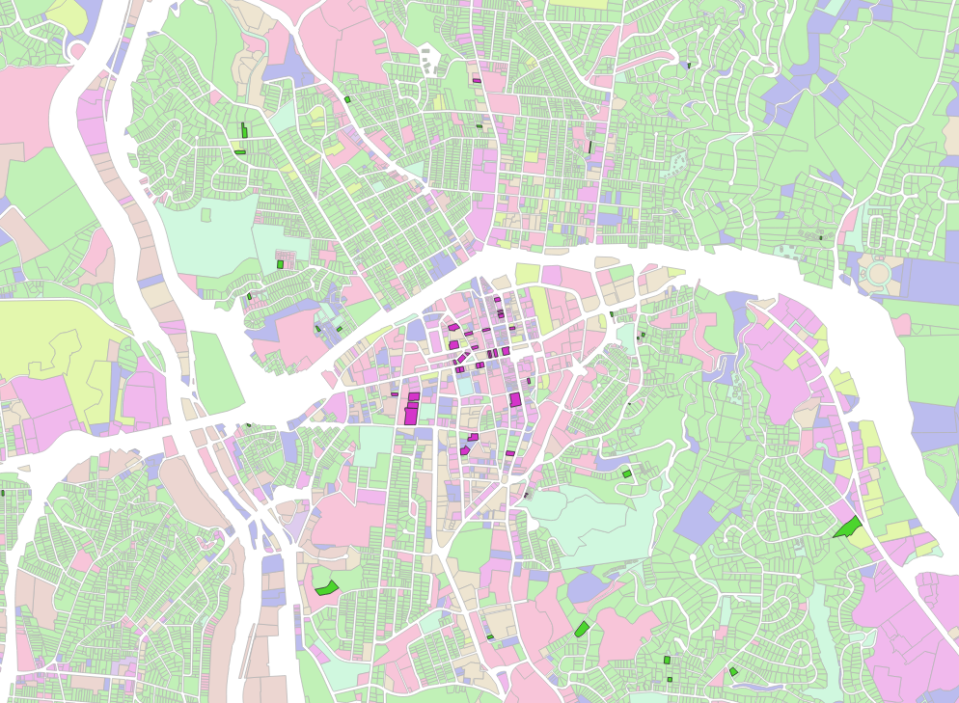
2025-2030

Slide 13
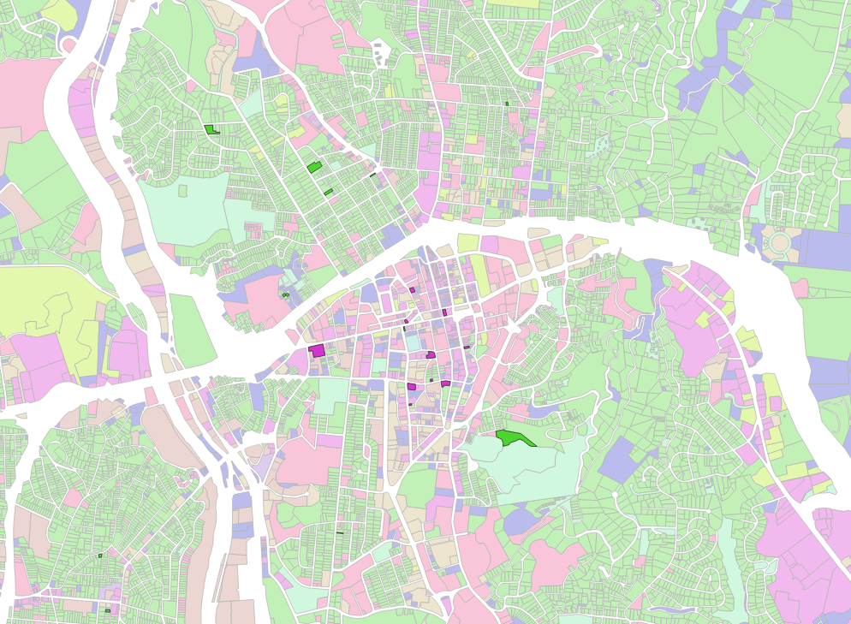
2030-2035

Slide 14
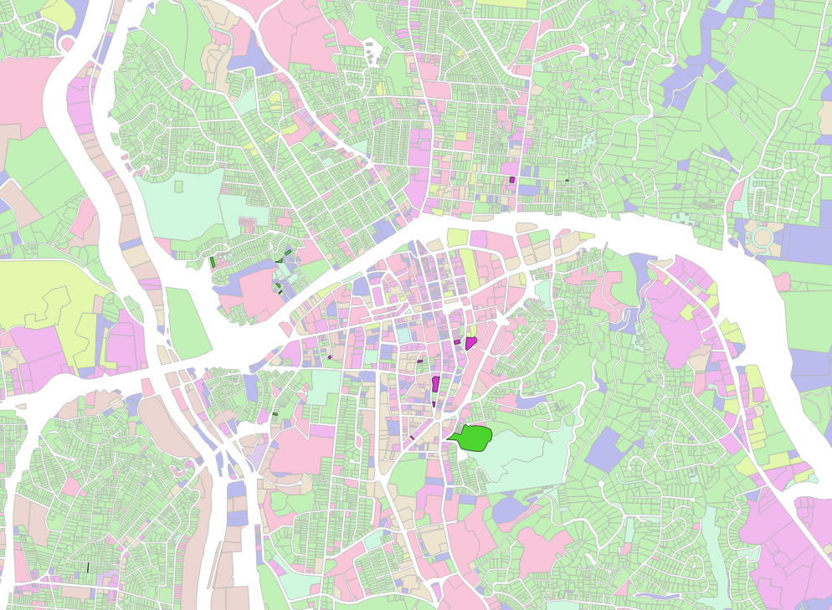
2035-2040

Slide 15

2040-2045

Slide 16
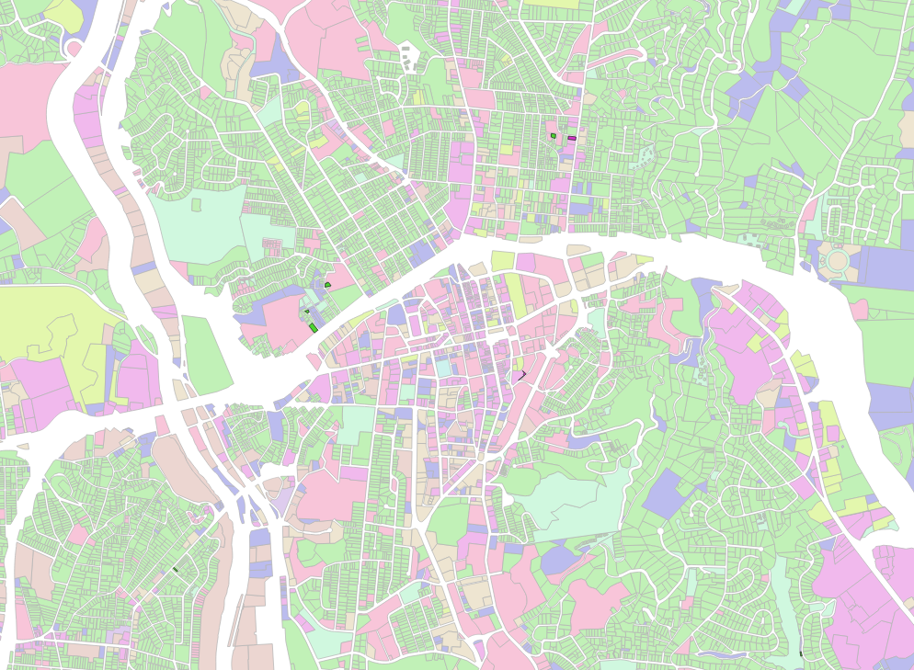
2045-2050

Slide 17
Prior Time-Step
Current Time-Step
Parcel
ELUSE
LUC-LM
ELUSE
Block
ACCESS
CAPACITY
BUILD-OUT
MPI
ALLOCATION
UNITS
TAZ
MPI
BID-AUCTION
SE DATA

Slide 18






Allocation Model (OLAF)
Land Suitability
(accessibility, infrastructure, buffers)
Constraints (natural & human)
Constrained location choice with Monte Carlo simulation
Incorporate known projects and estimated build-out capacity
Allow allocation of declines as well as growth (job loss, housing churn)
Suitability functions estimated from observed dynamics; use MPI

Slide 19










Residential Bid Model
Choice of occupant
Maximize bid / utility
Household/job characteristics
Size (persons per HH/firm)
Income (per HH/employee)
Area characteristics
Transportation accessibility
Household and job density
Other area characteristics
Housing unit type

Slide 20
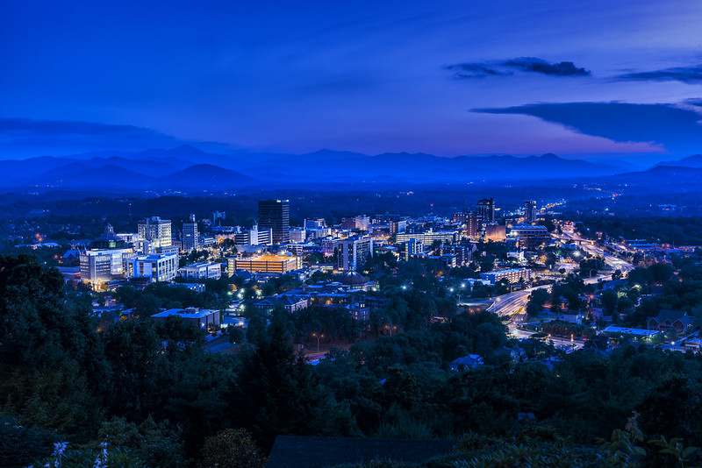

CONCLUSIONS
Applications of generative AI in urban planning and travel forecasting may not look like they do in other fields
Language models can be helpful for more than question-answer chatbots
It’s possible to develop and apply AI without infringing basic copyright or data dignity protections.
Useful AI applications can complement without replacing existing workflows
It’s easier to work at the spatial and temporal resolution that makes sense for the policy or data source at hand, rather than doing everything at the same level.

Slide 21

Questions
And
Comments

Slide 22
MANHAN
manhan.co
cbrown@manhan.co

